Slide 1
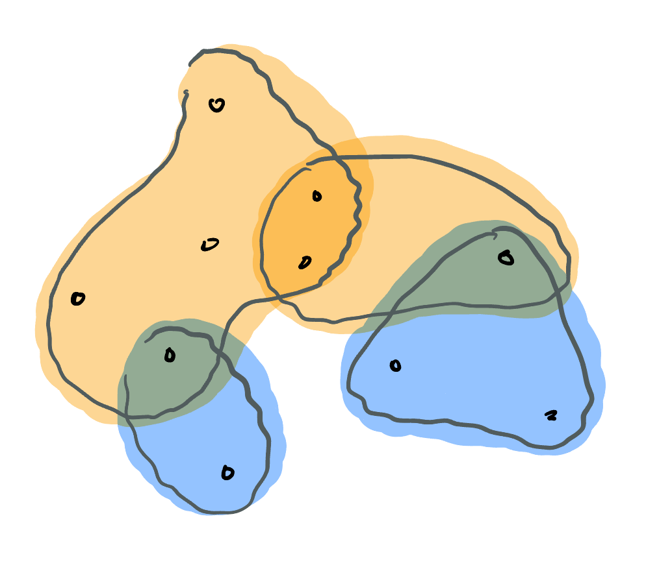
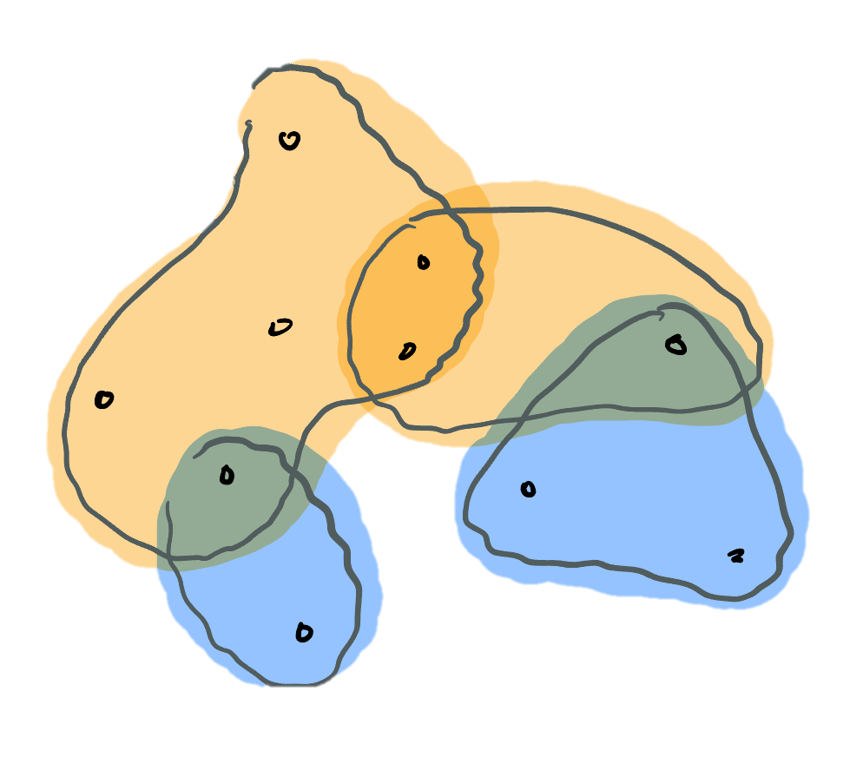
Submodular Hypergraph Partitioning
Antares Chen
University of Chicago
ICALP 2025

Slide 2


Joint work with…
Erasmo Tani
Sapienza Università di Roma
Computer Science
Lorenzo Orecchia
University of Chicago
Computer Science
[LO] [ET] [AC]
arXiv:2301.08920

Slide 3
What’s this talk about?
Hypergraph partitioning
Well, mostly…
Maybe some thoughts on future directions
Notes:
Well… mostly, I’ll also talk about one of my favorite problems: sparsest cut.

Slide 4
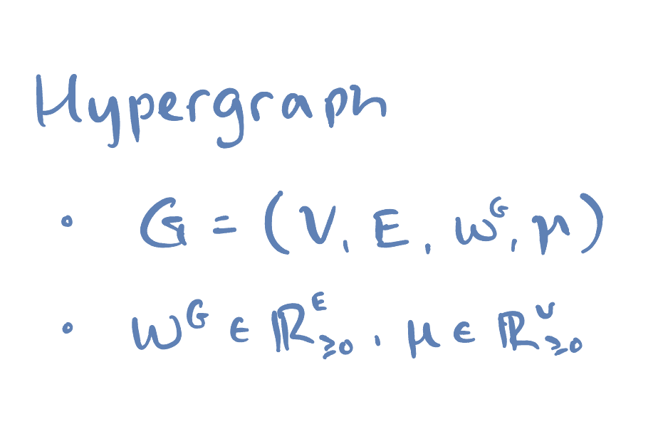
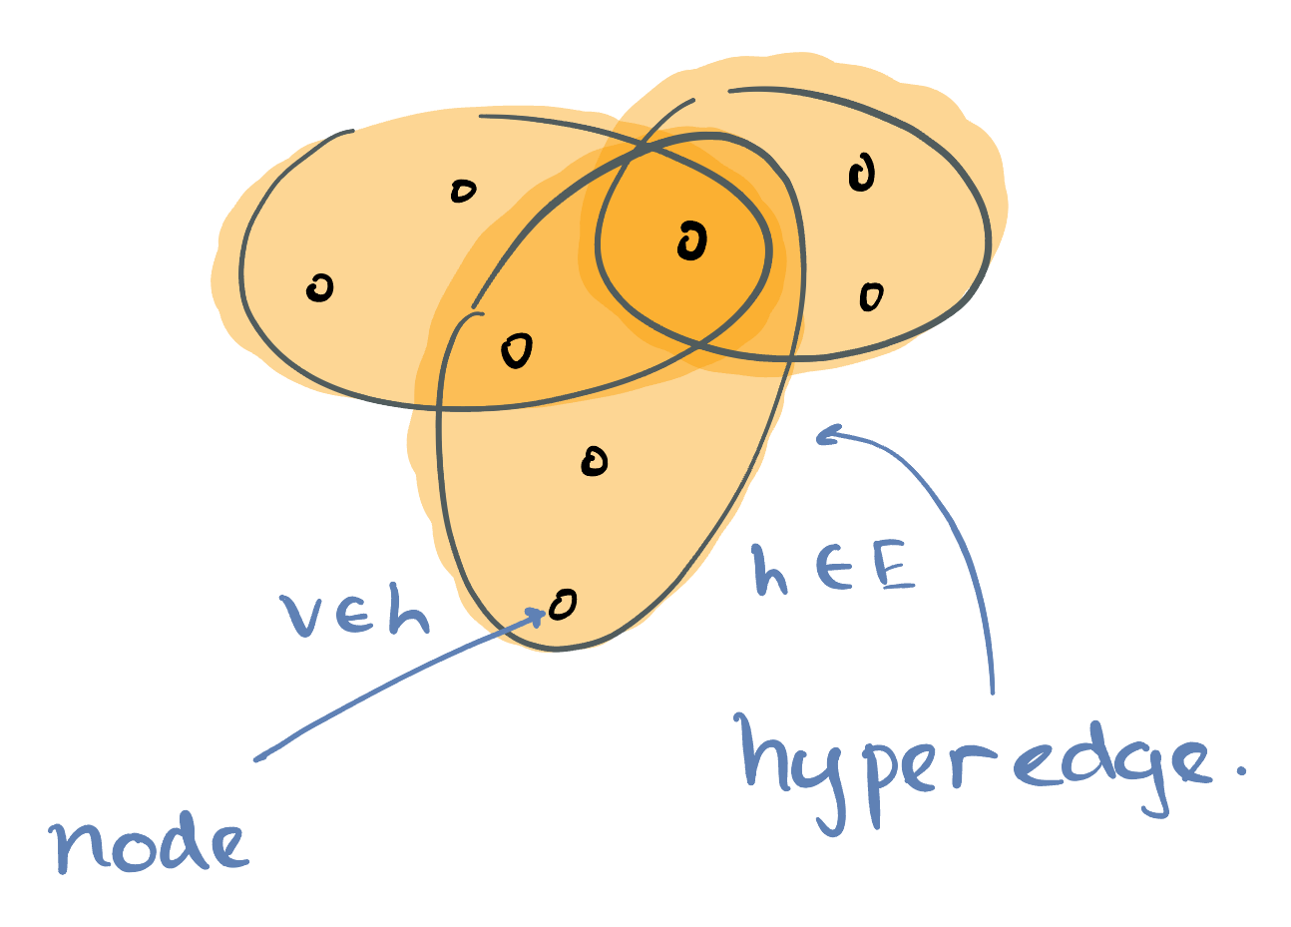
Hypergraphs
Are set systems…
Notes:
Generalization of graphs:
Whereas graphs are capture association between two objects, hypergraphs capture higher arity association (between many objects)

Slide 5
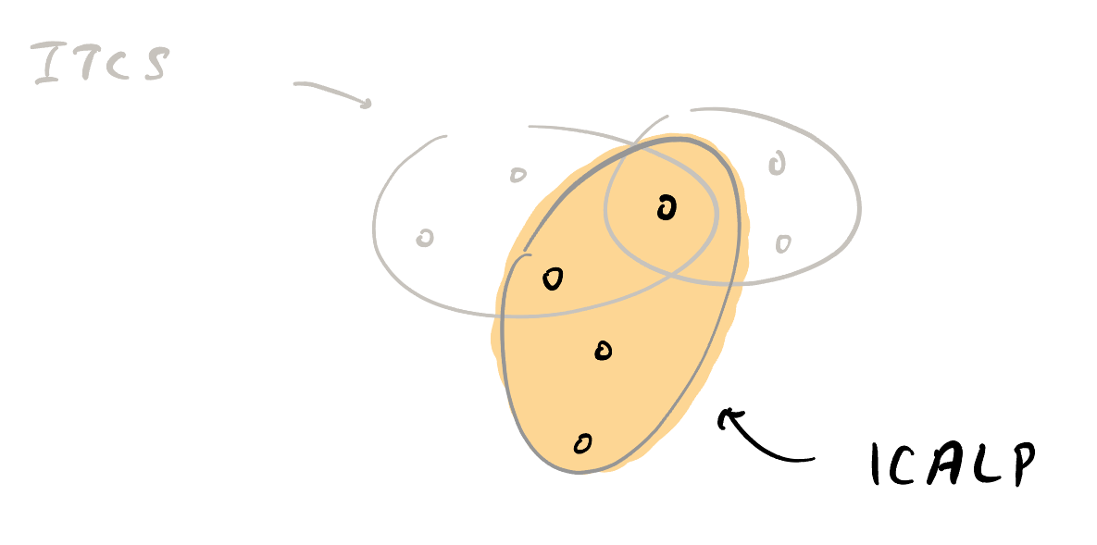
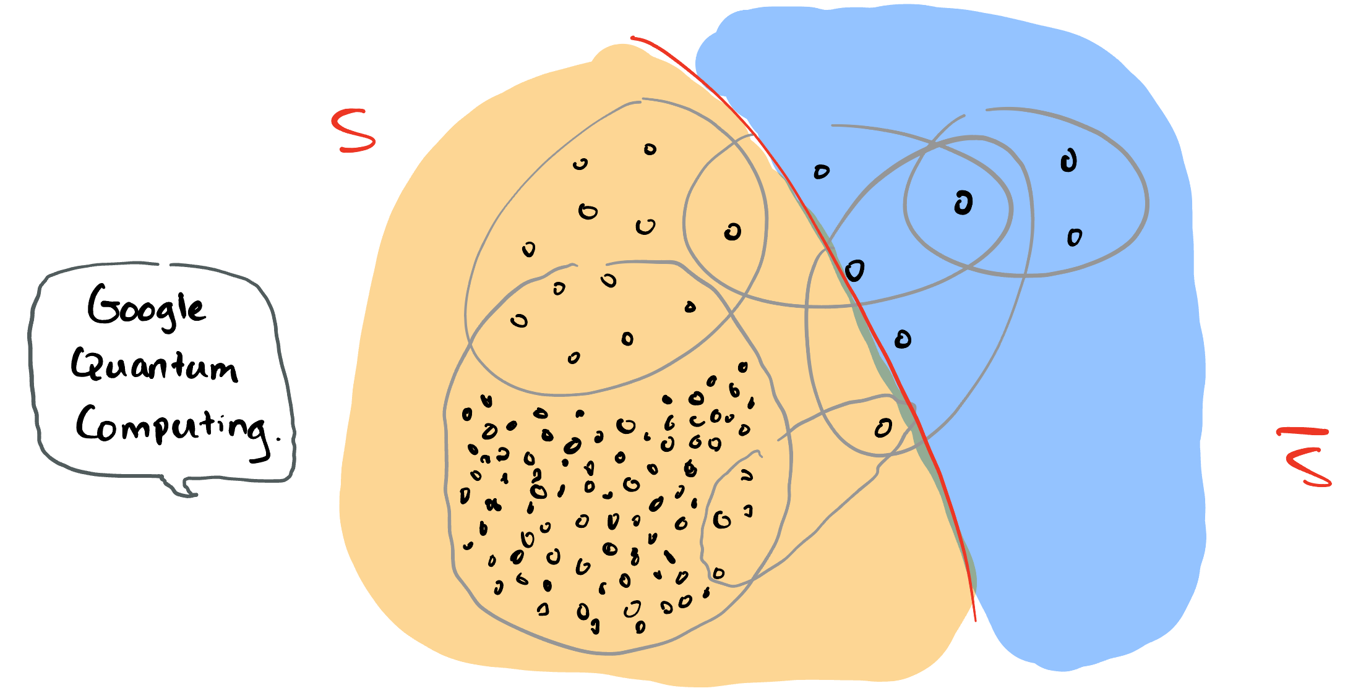
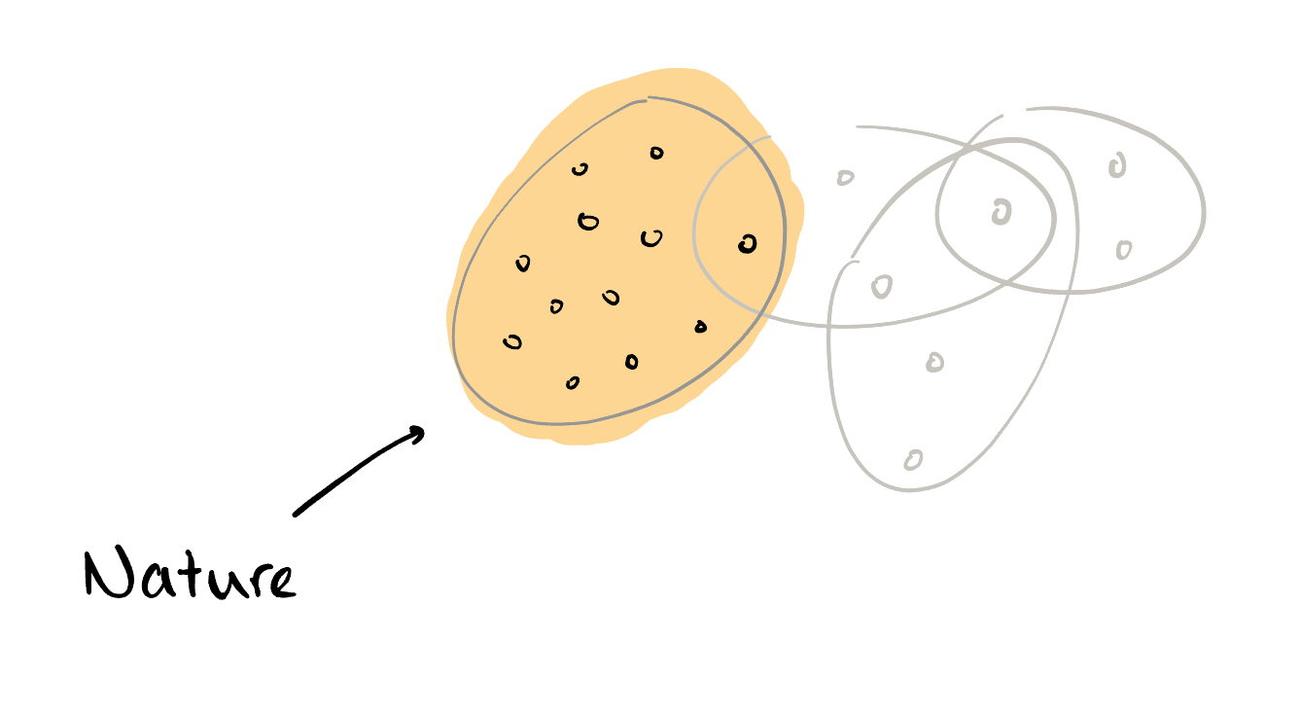
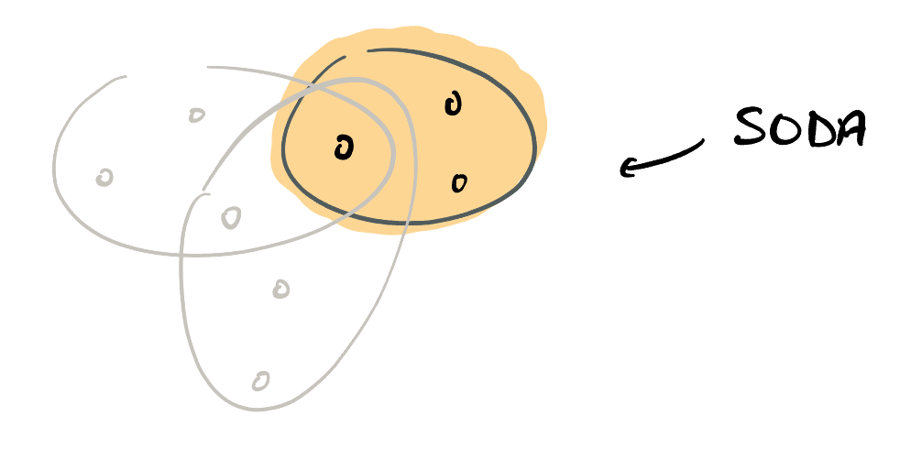
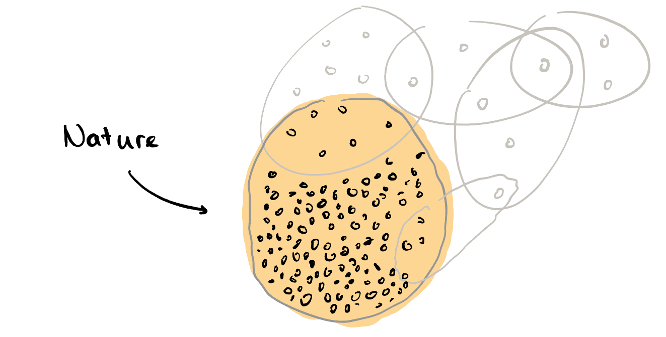
Hypergraph partitioning
Notes:
Quantum supremacy using a programmable superconducting processor John Martinis
Scalable quantum simulation of molecular energies John Martinis -> Peter Love
Limitations of Local Quantum Algorithms on Random MAX-k-XOR and Beyond. Peter Love -> Jonathan (ICALP
Polynomial-Time Tensor Decompositions with Sum-of-Squares. Jonathan (in Theoretical Computer Science)

Slide 6
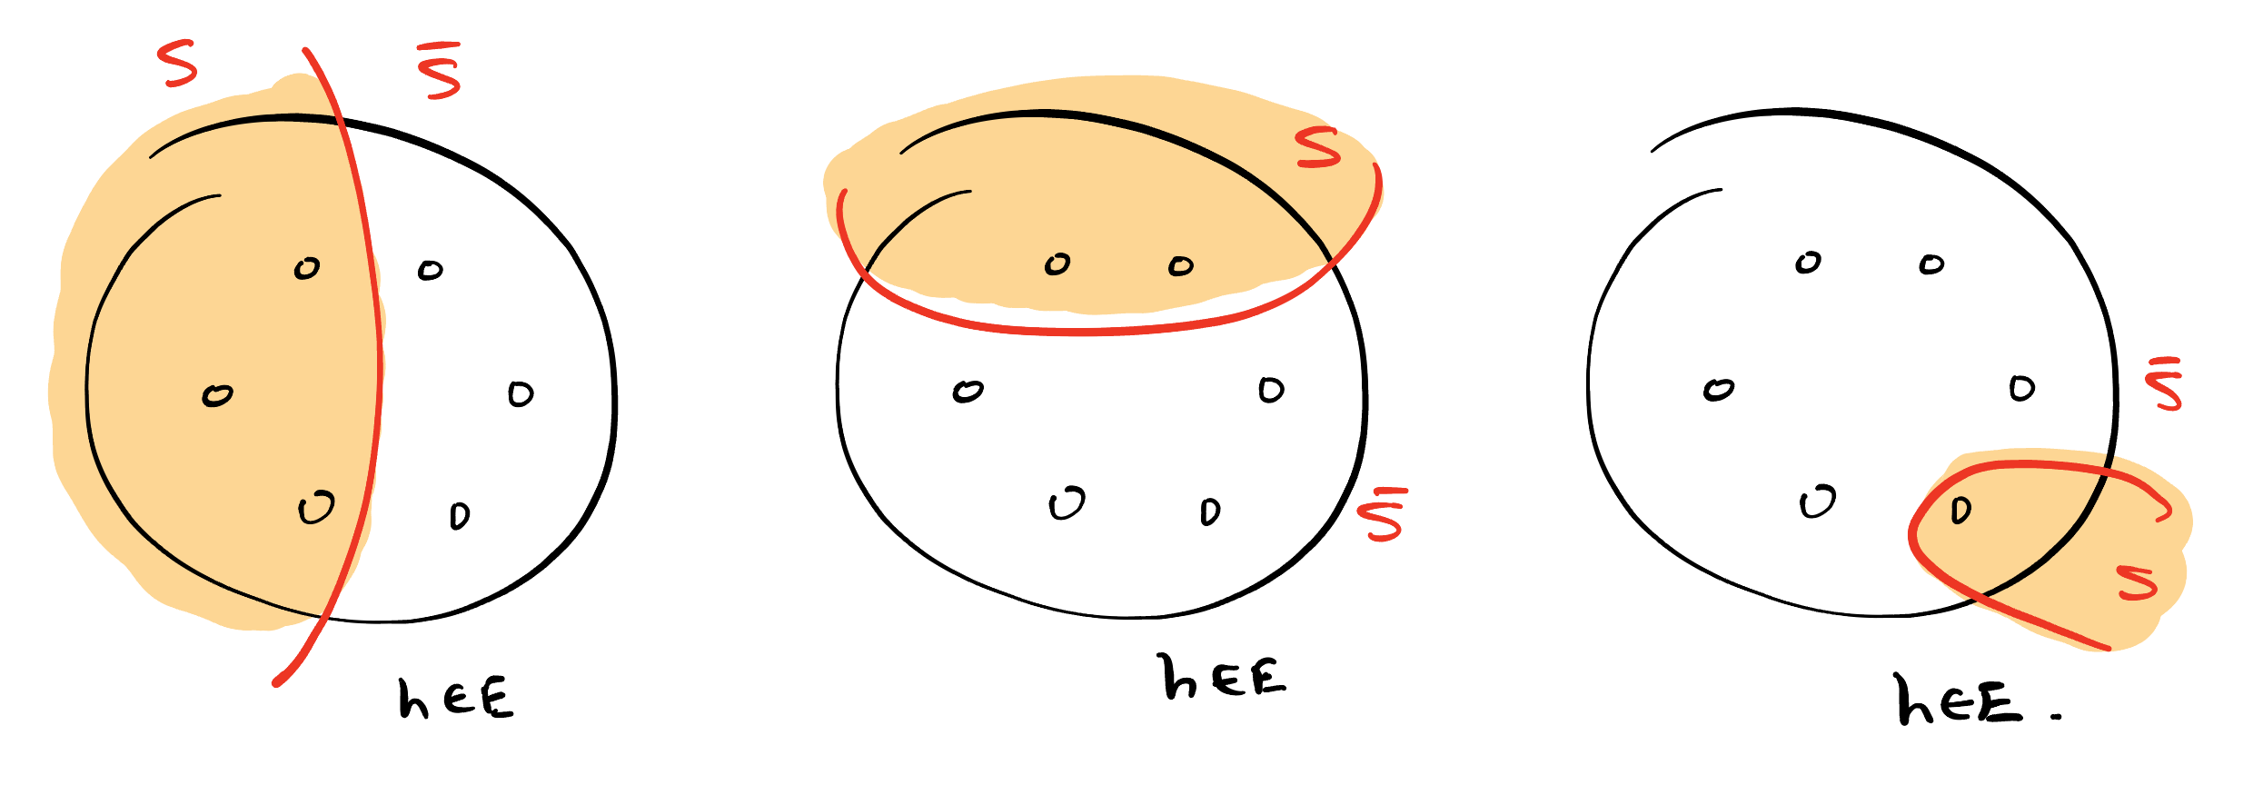
But hyperedges can be cut in multiple ways…
Need to quantitatively distinguish different cuts of a hyperedge

Slide 7
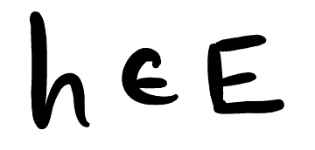
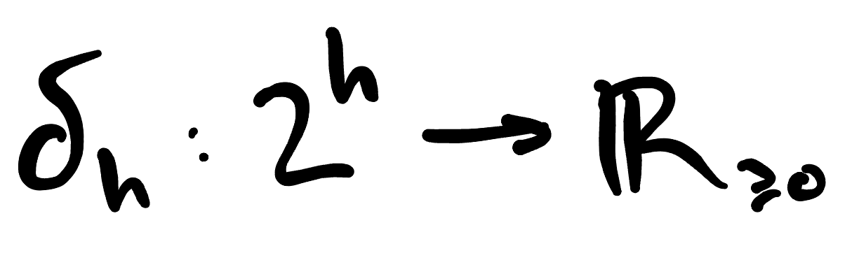
But hyperedges can be cut in multiple ways…
Equip each hyperedge with a cut function
Notes:
Set functions: outputs the value of “cutting” a hyperedge where the cut is specified by the intersection of S and h

Slide 8
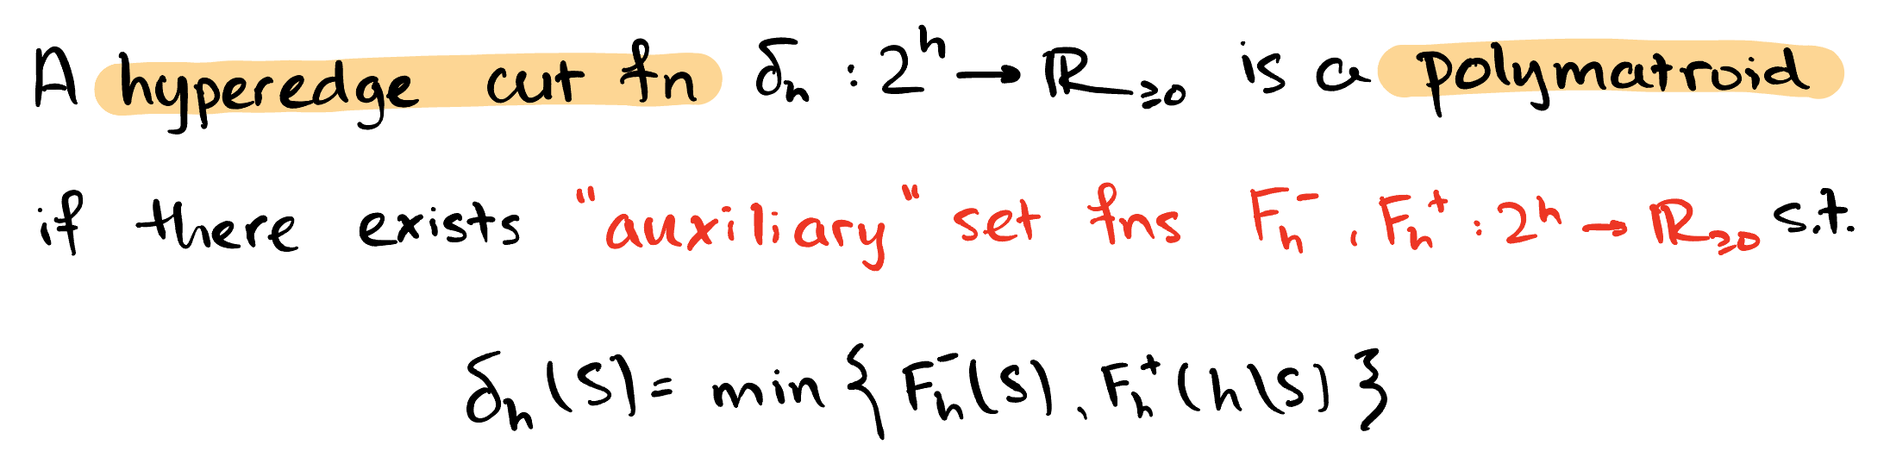
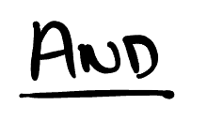
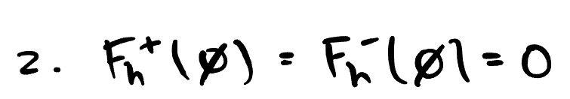
Polymatroidal cut functions
Notes:
We’re going to equip each hyperedge with a “cut function"

Slide 9

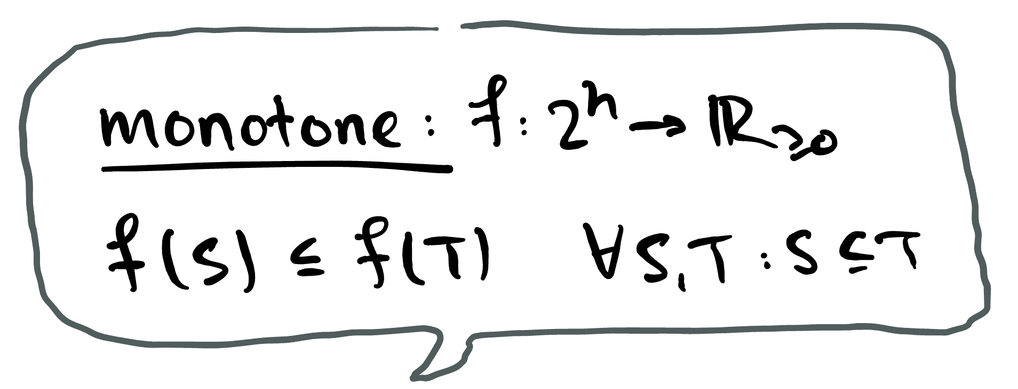
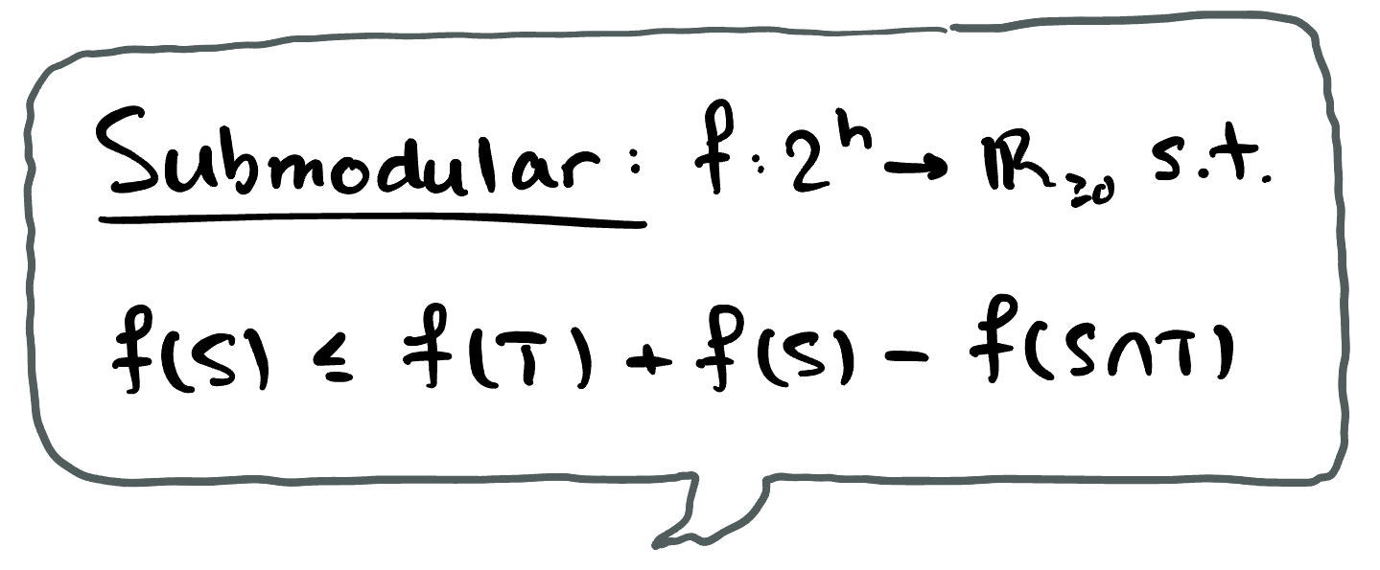

Polymatroidal cut functions

Slide 10
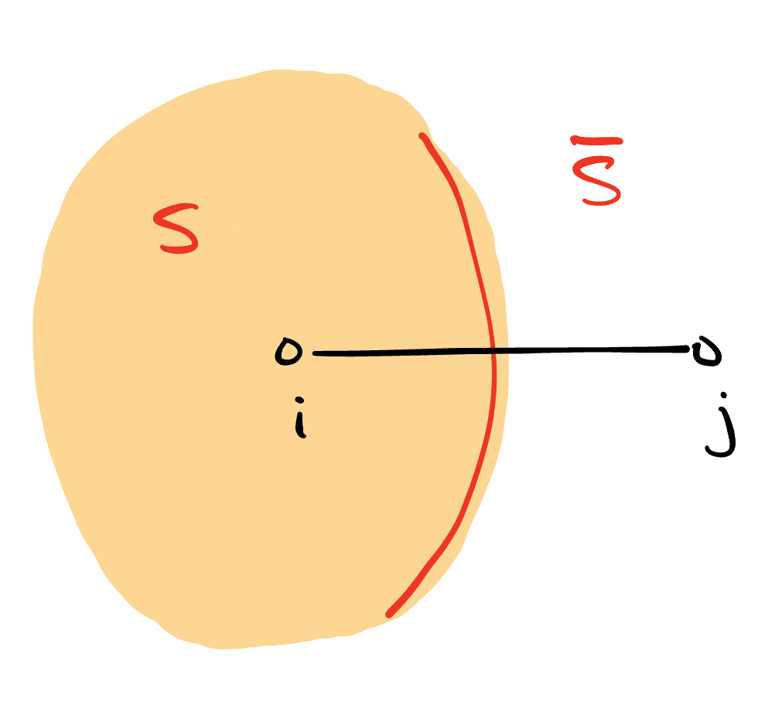
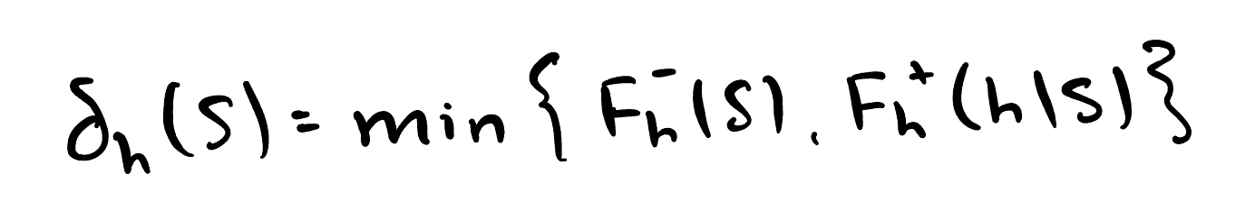
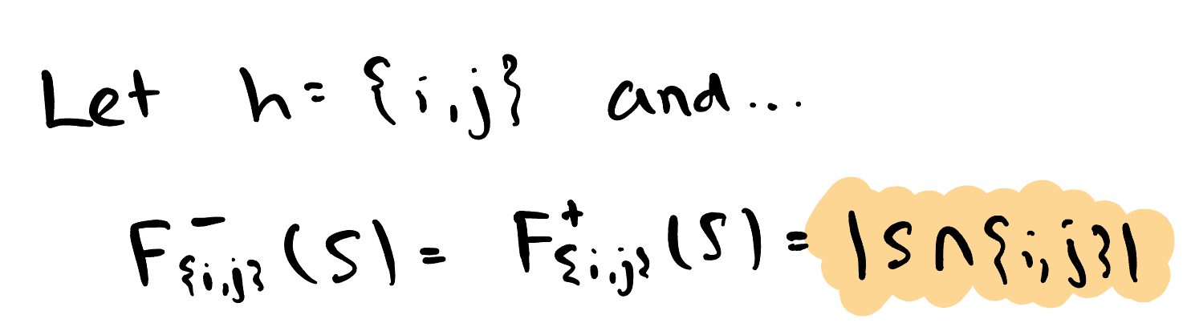
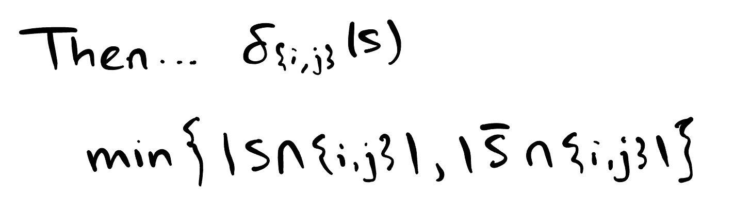
Example
Take an undirected graph…
Notes:
Mention something about asymmetric case

Slide 11
Why polymatroidal cut functions?
Expressive – Captures many typically considered (hyper)graph partitioning objectives.
Structured – Metric and flow techniques apply to produce fast approximation algorithms.
Well-studied – Reasonable body work on this + related hypergraph partitioning models [CKRV11] [CL24] [LM18] [Yos17]

Slide 12
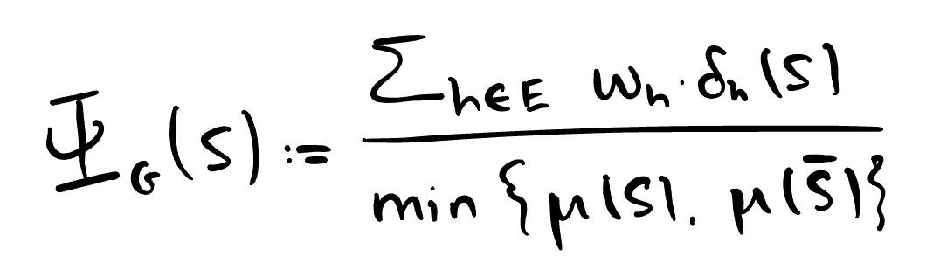
Ratio-cuts for submodular hypergraphs
Input –
Output –
Notes:
If you … then you get back expansion
Sparsest cut is really the problem one should always keep in the back of their mind when thinking about this.

Slide 13
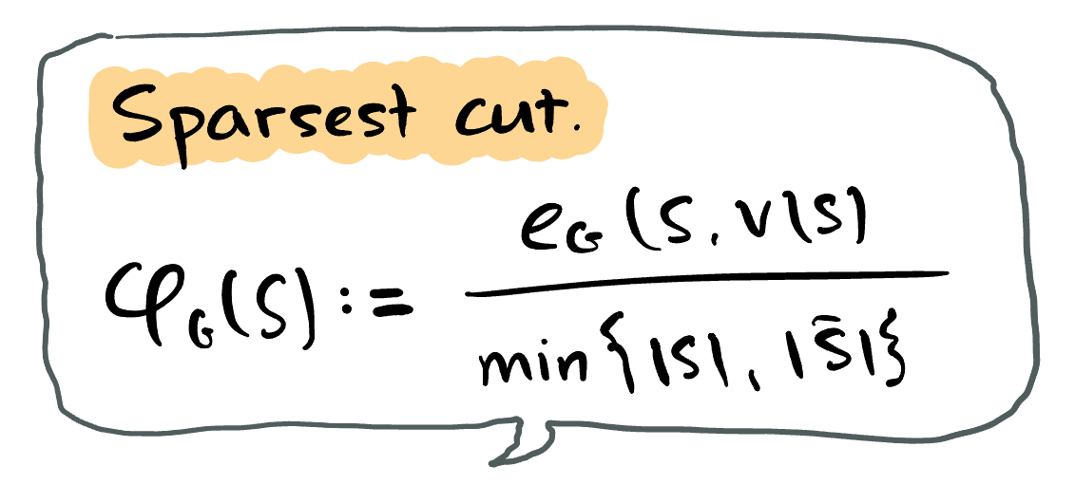
Ratio-cuts for submodular hypergraphs
Input –
Output –
Notes:
If you … then you get back expansion
Sparsest cut is really the problem one should always keep in the back of their mind when thinking about this.

Slide 14
Ratio-cuts for submodular hypergraphs
Input –
Output –
Goal – Find fast algorithms which output polylogarithmic approximations to minimum ratio cut.
Notes:
Sparsest cut is really the problem one should always keep in the back of their mind when thinking about this.

Slide 15
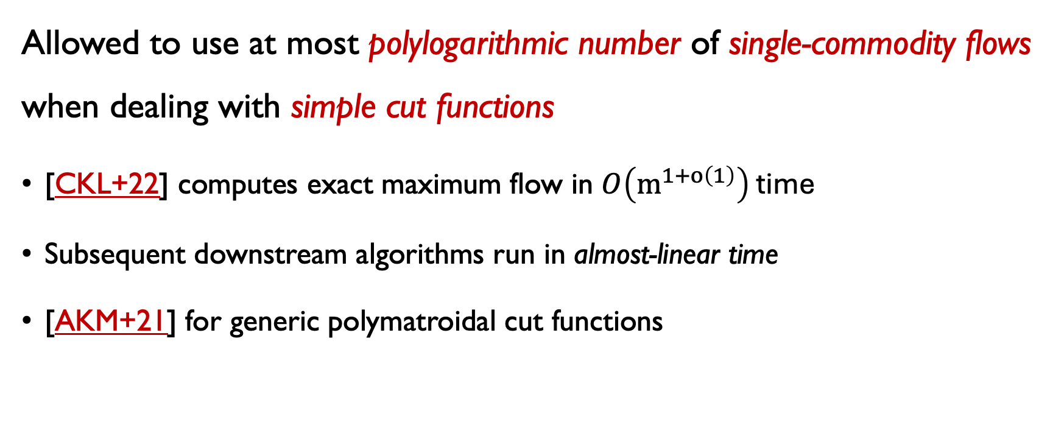
What do we mean by fast?
Allowed to use at most polylogarithmic number of single-commodity flows when dealing with simple cut functions
[CKL+22] computes exact maximum flow in $O\left(m^{1+o\left(1\right)}\right)$ time
Subsequent downstream algorithms run in almost-linear time
[AKM+21] for generic polymatroidal cut functions
Notes:
Simple as in undirected and directed graphs
For hypergraphs, you have to think about submodular function minimization
Running time is something on the order of
(poly(r) * eval_oracle + T_maxflow(n, n + poly(r))) * log 1/eps
r is rank
T_maxflow(n, m) is time to evaluate maxflow on a graph with n vertices and m edges.
And you get an additive eps approximation

Slide 16
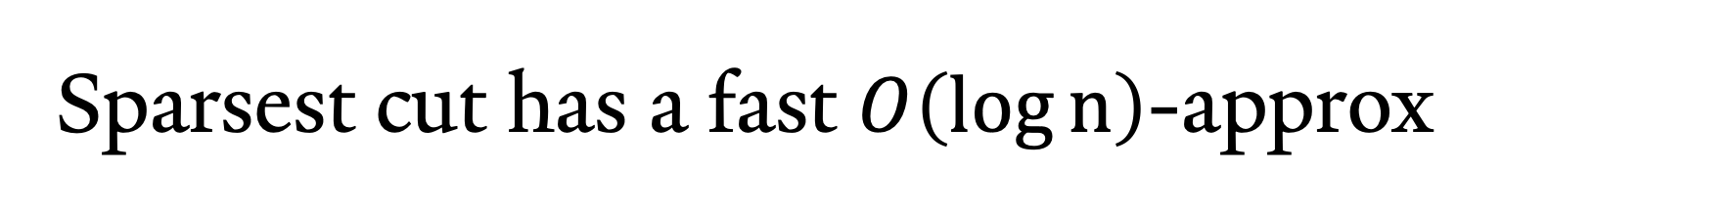

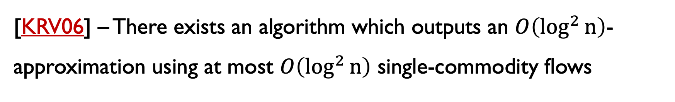
Sparsest cut has a fast $O\left(\log{n}\right)$-approx
[KRV06] – There exists an algorithm which outputs an $O\left(\log^{2}{n}\right)$-approximation using at most $O\left(\log^{2}{n}\right)$ single-commodity flows
[OSVV08] – $O\left(\log{n}\right)$-approximation using $O\left(\log^{2}{n}\right)$ flows

Slide 17
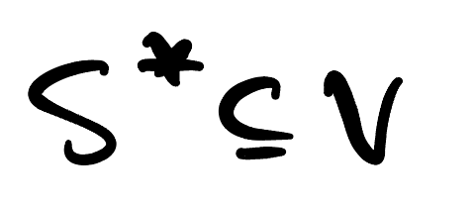
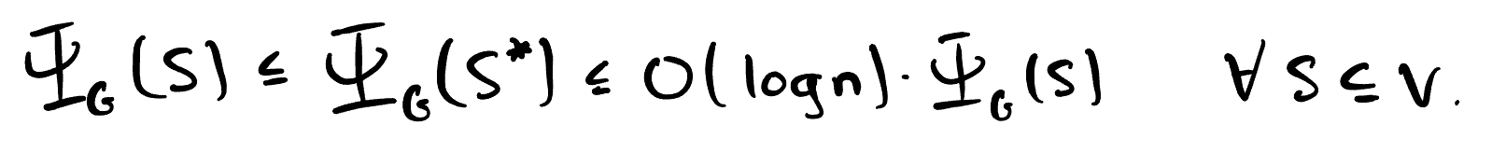
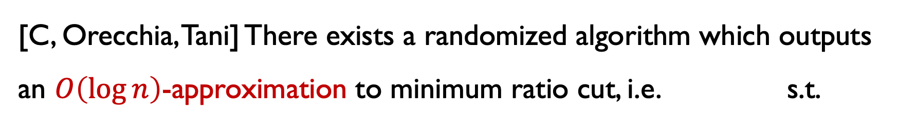
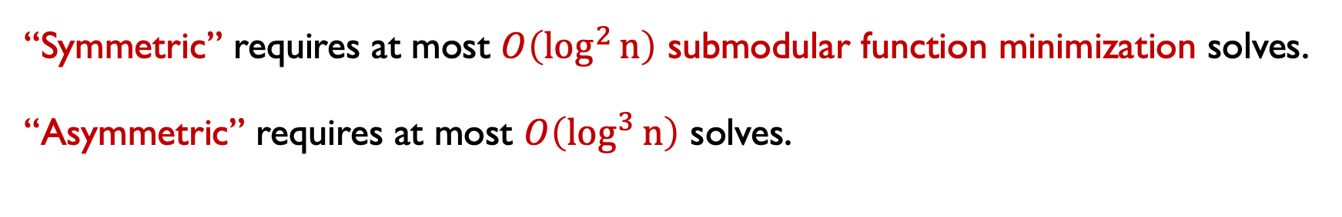
Results I
[C, Orecchia, Tani] There exists a randomized algorithm which outputs an $O\left(\log{n}\right)$-approximation to minimum ratio cut, i.e. s.t.
“Symmetric” requires at most $O\left(\log^{2}{n}\right)$ submodular function minimization solves.
“Asymmetric” requires at most $O\left(\log^{3}{n}\right)$ solves.

Slide 18
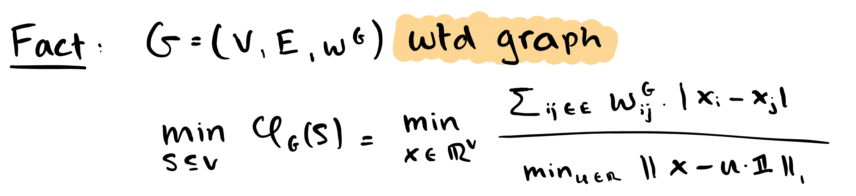
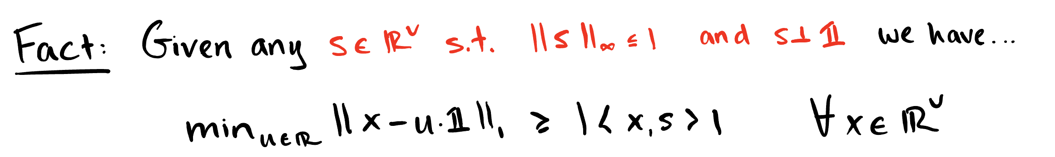
Algorithm sketch
Let’s focus on sparsest cut…
Notes:
From an optimization perspective, the L1 problem is super unruly
So if you do a bit of Bayesian statistics / variational inference, when you have a non-convex loss, a common strategy is to upper bound it with a convex surrogate loss and try to minimize that
It’s important we wrote the denominator variationally, because this gives us a upper bound to pick: take the dual

Slide 19
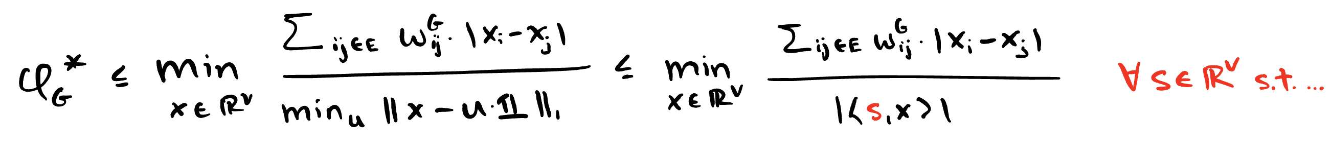
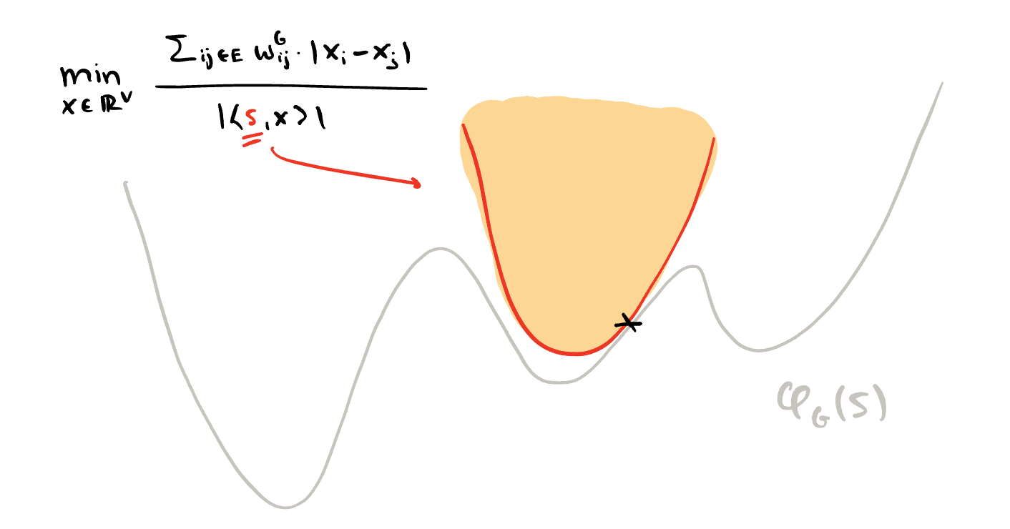
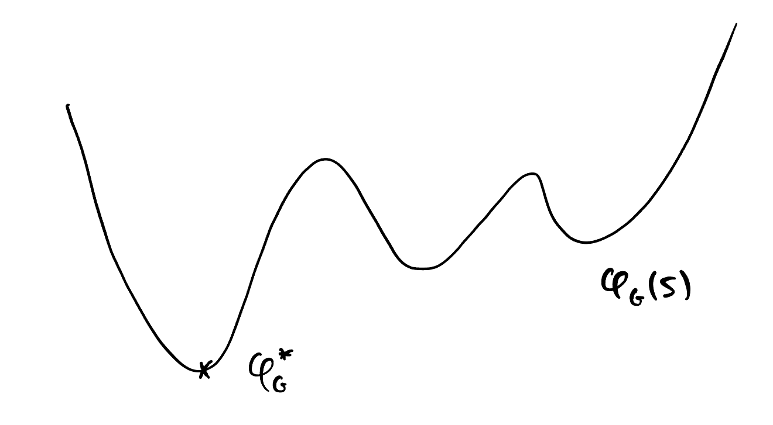
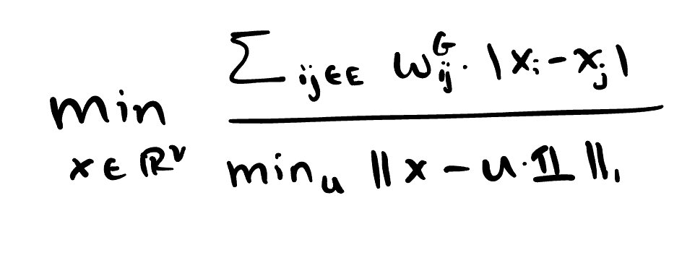
Algorithm sketch
Notes:
Now for every s, you have a local upper bound
But what is that problem? It’s an LP / cut improvement
Take the dual, you get maxflow
If you know something about maxflow: demand graphs associated with single-commodity flows certify lower bounds on the expansion of the graph
You have a local certificate to the expansion (local in the sense that the quality of the certificate varies with s)
If you want to approximate expansion, it is enough to certify a good global lower bound
Locality depends only on this parameter s… so cover all s by picking as short of a sequence of such s’s as possible
That’s the cut matching game.

Slide 20
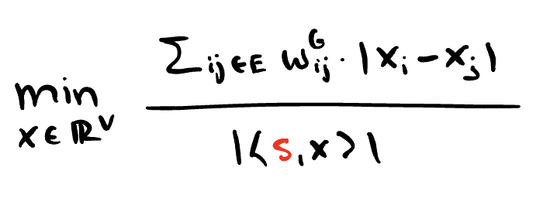
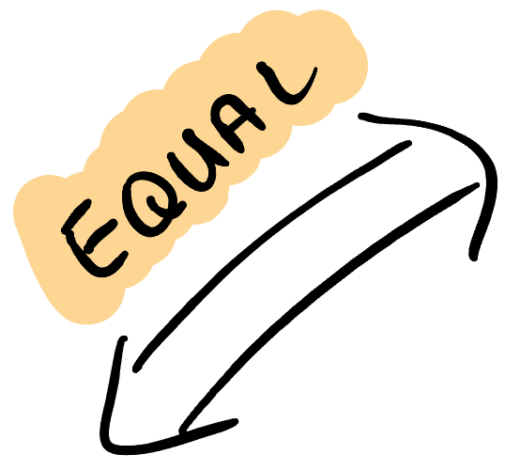
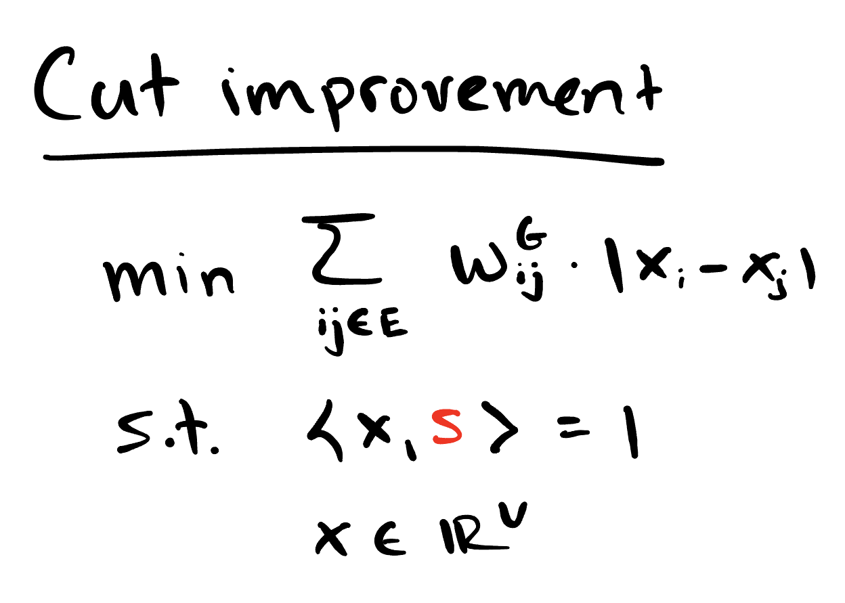
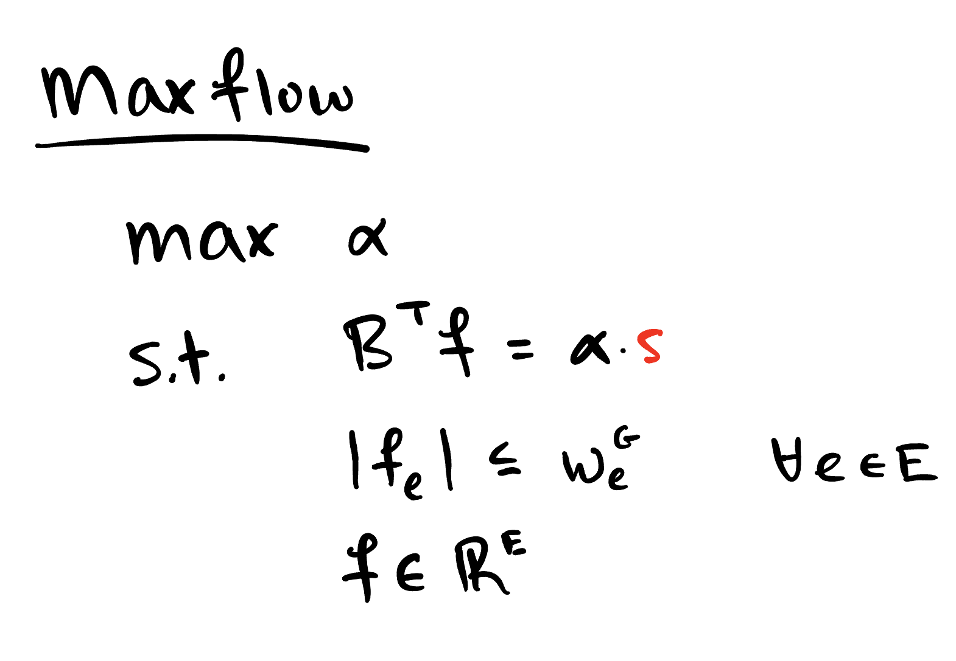
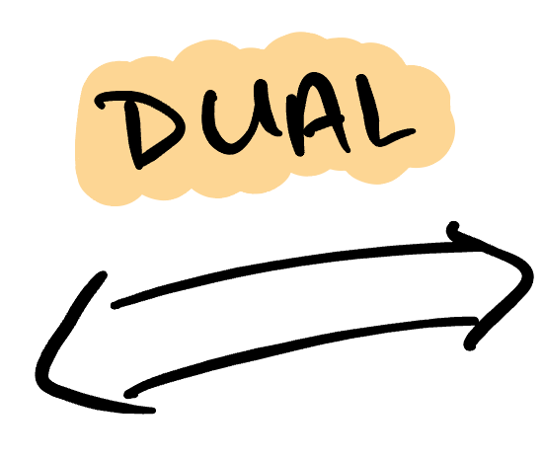
Algorithm sketch
Notes:
Now for every s, you have a local upper bound
But what is that problem? It’s an LP / cut improvement
Take the dual, you get maxflow
If you know something about maxflow: demand graphs associated with single-commodity flows certify lower bounds on the expansion of the graph
You have a local lower bound to the expansion
If you want to approximate expansion, it is enough to certify a good global lower bound
Locality depends only on this parameter s… so cover all s by picking as short of a sequence of such s’s as possible
That’s the cut matching game.

Slide 21
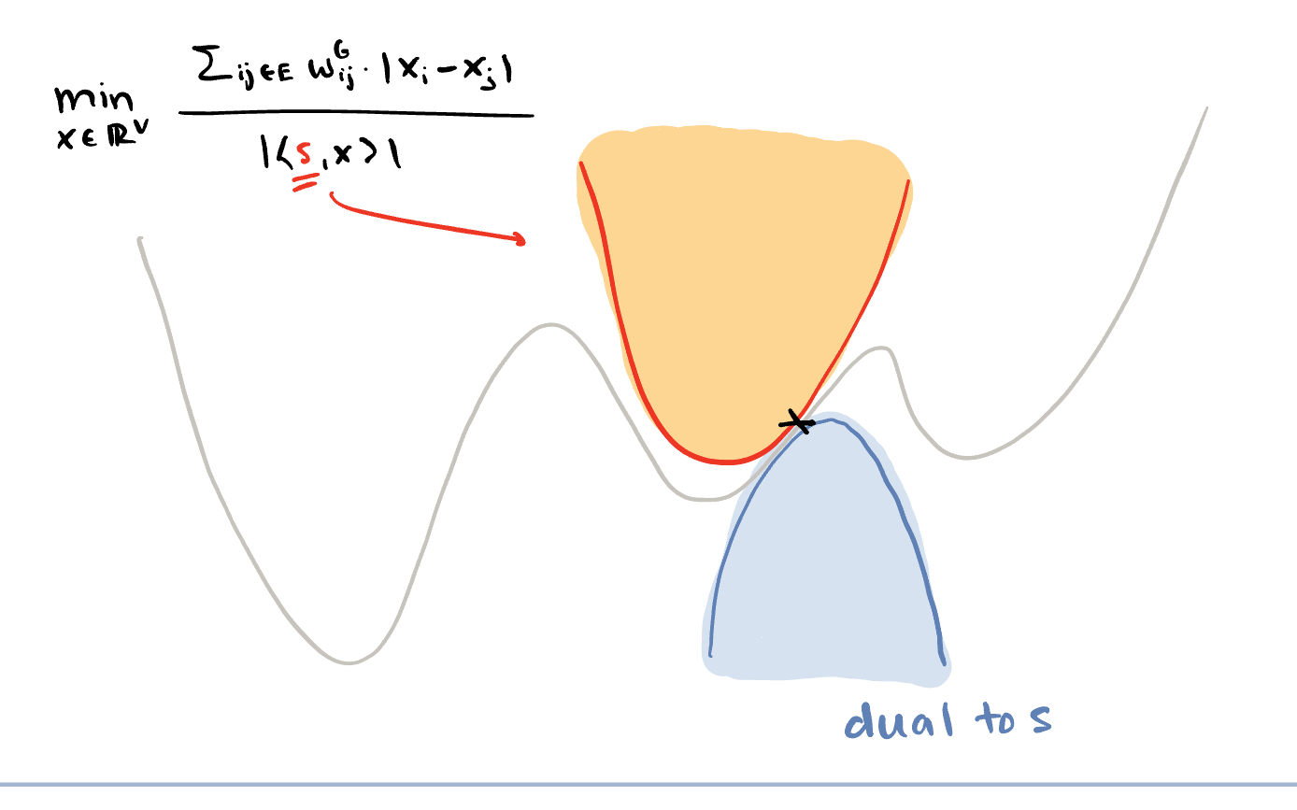
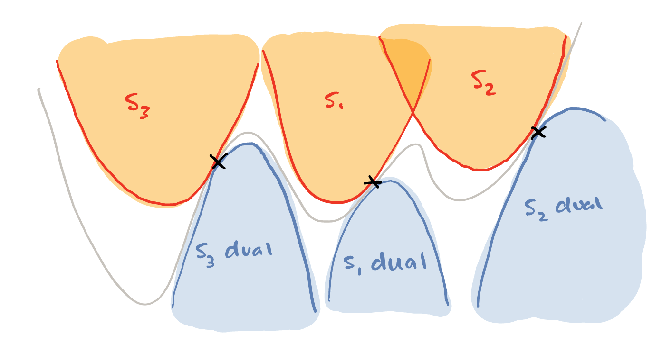
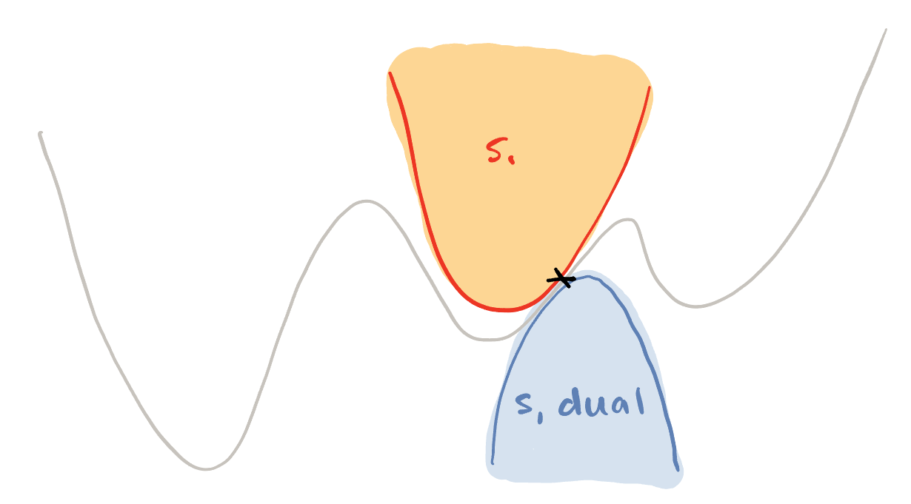
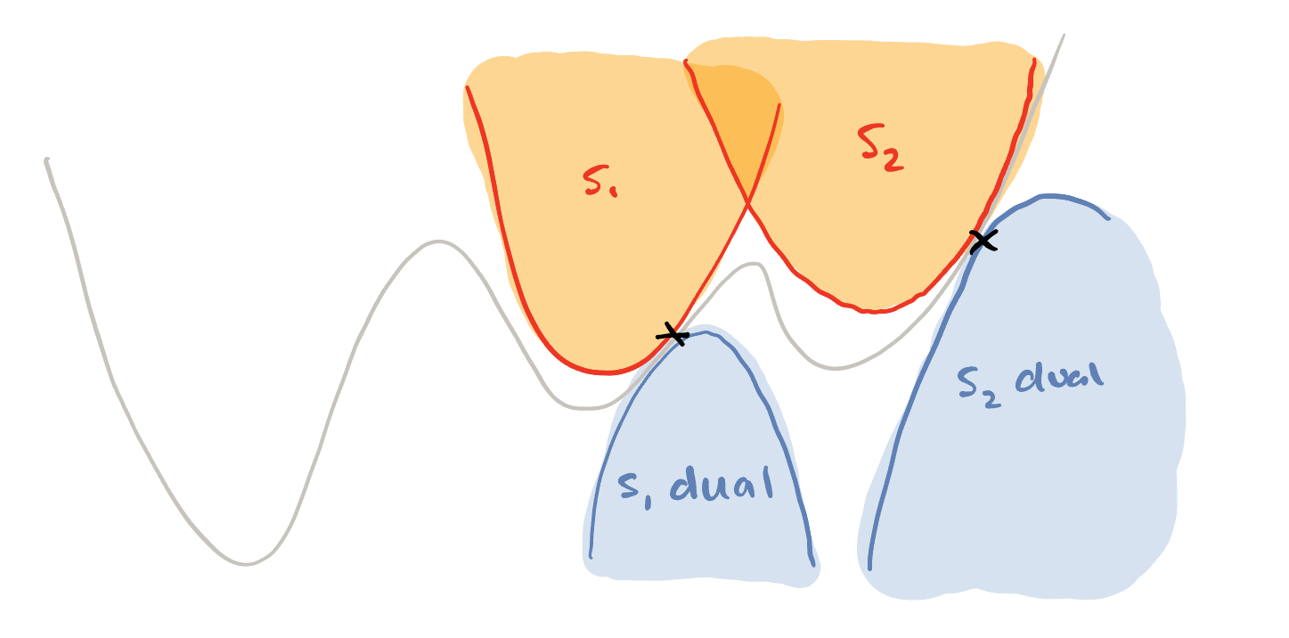
Algorithm sketch
To approximate sparsest cut, need to find a good global lower bound
Notes:
Now for every s, you have a local upper bound
But what is that problem? It’s an LP / cut improvement
Take the dual, you get maxflow
If you know something about maxflow: demand graphs associated with single-commodity flows certify lower bounds on the expansion of the graph
You have a local lower bound to the expansion
If you want to approximate expansion, it is enough to certify a good global lower bound
Locality depends only on this parameter s… so cover all s by picking as short of a sequence of such s’s as possible
That’s the cut matching game.
Pause for questions at the end

Slide 22
Algorithm sketch
This is the cut-matching game
Notes:
Now for every s, you have a local upper bound
But what is that problem? It’s an LP / cut improvement
Take the dual, you get maxflow
If you know something about maxflow: demand graphs associated with single-commodity flows certify lower bounds on the expansion of the graph
You have a local lower bound to the expansion
If you want to approximate expansion, it is enough to certify a good global lower bound
Locality depends only on this parameter s… so cover all s by picking as short of a sequence of such s’s as possible
That’s the cut matching game.
Pause for questions at the end

Slide 23
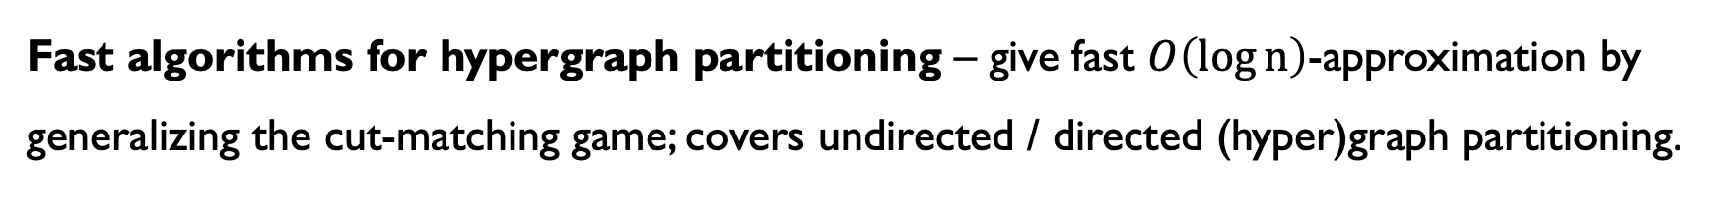

Conclusion
Fast algorithms for hypergraph partitioning – give fast $O\left(\log{n}\right)$-approximation by generalizing the cut-matching game; covers undirected / directed (hyper)graph partitioning.
Open question – Can you find a $O\left(\sqrt{\log{n}} \right)$-approximation for minimum ratio cut over polymatroidal cut functions using at most polylog maxflows?

Slide 24
Flip it on its head…
Analytic versions of combinatorial primitives – Give a continuous representation of the cut-matching game so that we can talk about “geometric” phenomena driving the method
Is your interpretation of the method’s “geometry” correct?
Try generalizing the techniques…
Notes:
Is the point REALLY to find fast algorithms?

Slide 25
Thank you!
Questions?

Slide 26
References
[AKM+21] Axiotis, K., Karczmarz, A., Mukherjee, A., Sankowski, P., & Vladu, A. (202). Decomposable submodular function minimization via maximum flow. In International Conference on Machine Learning (pp. 446-456). PMLR.
[CKL+22] Chen, L., Kyng, R., Liu, Y., Peng, R., Probst Gutenberg, M., & Sachdeva, S. (2025). Maximum flow and minimum-cost flow in almost-linear time. Journal of the ACM, 72(3), 1-103.
[CKRV11] Chekuri, C., Kannan, S., Raja, A., & Viswanath, P. (2012). Multicommodity flows and cuts in polymatroidal networks. In Proceedings of the 3rd Innovations in Theoretical Computer Science Conference (pp. 399-408).
[CL24] Chekuri, C., & Louis, A. (2024). On Sparsest Cut and Conductance in Directed Polymatroidal Networks. arXiv preprint arXiv:2410.20525.

Slide 27
References
[LM18] Li, P., & Milenkovic, O. (2018). Submodular hypergraphs: p-laplacians, cheeger inequalities and spectral clustering. In International Conference on Machine Learning (pp. 3014-3023). PMLR.
[LTW24] Lau, L. C., Tung, K. C., & Wang, R. (2024). Fast algorithms for directed graph partitioning using flows and reweighted eigenvalues. In Proceedings of the 2024 Annual ACM-SIAM Symposium on Discrete Algorithms (SODA) (pp. 591-624). Society for Industrial and Applied Mathematics.
[KRV06] Khandekar, R., Rao, S., & Vazirani, U. (2009). Graph partitioning using single commodity flows. Journal of the ACM (JACM), 56(4), 1-15.
[OSVV08] Orecchia, L., Schulman, L. J., Vazirani, U. V., & Vishnoi, N. K. (2008, May). On partitioning graphs via single commodity flows. In Proceedings of the fortieth annual ACM symposium on Theory of computing (pp. 461-470).

Slide 28
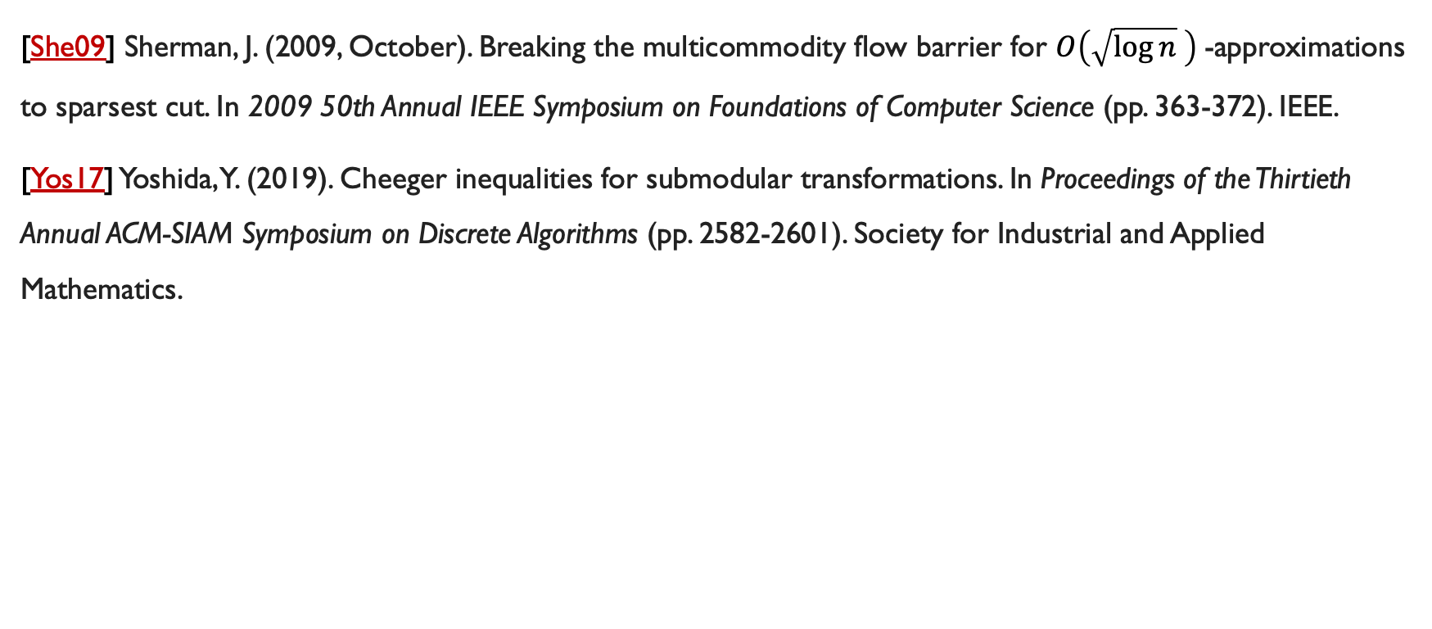
References
[She09] Sherman, J. (2009, October). Breaking the multicommodity flow barrier for $O\left(\sqrt{\log{n}} \right)$-approximations to sparsest cut. In 2009 50th Annual IEEE Symposium on Foundations of Computer Science (pp. 363-372). IEEE.
[Yos17] Yoshida, Y. (2019). Cheeger inequalities for submodular transformations. In Proceedings of the Thirtieth Annual ACM-SIAM Symposium on Discrete Algorithms (pp. 2582-2601). Society for Industrial and Applied Mathematics.

Slide 29
Secret Stash

Slide 30
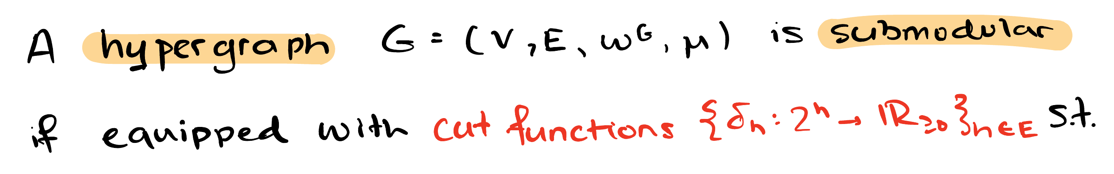

Submodular hypergraphs

Slide 31

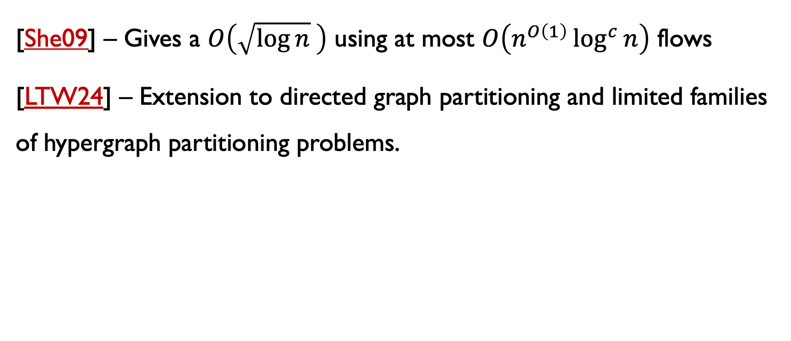
But sparsest cut has a fast $O\left(\sqrt{\log{n}} \right)$-approx!
[She09] – Gives a $O\left(\sqrt{\log{n}} \right)$ using at most $O\left(n^{O\left(1\right)}\log^{c}{n}\right)$ flows
[LTW24] – Extension to directed graph partitioning and limited families of hypergraph partitioning problems.

Slide 32
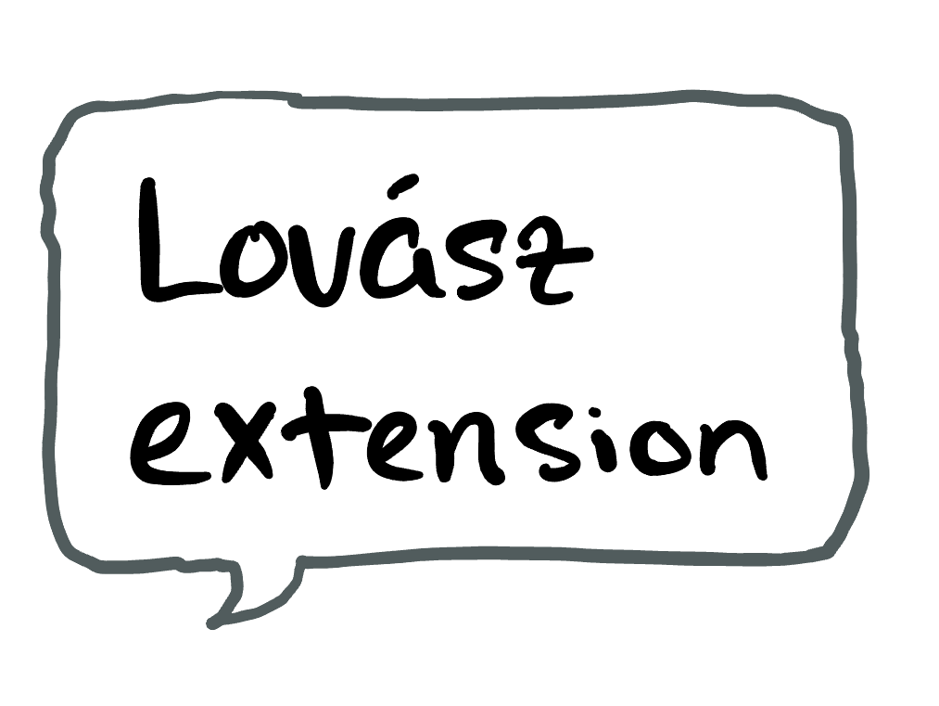


Results II
[C, Orecchia, Tani] There exists a randomized algorithm which returns a $O\left(\sqrt{\log{n}} \right)$-approximation for minimum ratio cut in polynomial time.
Algorithm rounds an $𝓁_{2}^{2}$-metric relaxation

Slide 33

Now… an open question
Can you find a $O\left(\sqrt{\log{n}} \right)$-approximation for minimum ratio cut over polymatroidal cut functions using a poly-logarithmic number of single-commodity flows?
Might require new solvers for submodular function minimization
Interesting versions even if looking at just sparsest cut…

Slide 34


Conclusion
Fast algorithms for hypergraph partitioning – give fast $O\left(\log{n}\right)$-approximation by generalizing the cut-matching game; covers undirected / directed (hyper)graph partitioning.
An “SDP” relaxation – we give an SDP relaxation for minimum ratio cut and show that it can be rounded to a $O\left(\sqrt{\log{n}} \right)$-approximation in polytime.
Open question – faster $O\left(\sqrt{\log{n}} \right)$-approximation may require new solvers for submodular function minimization.

